Slide 1

Capstone Project
Analysing Fantasy Premier League Football

Slide 2
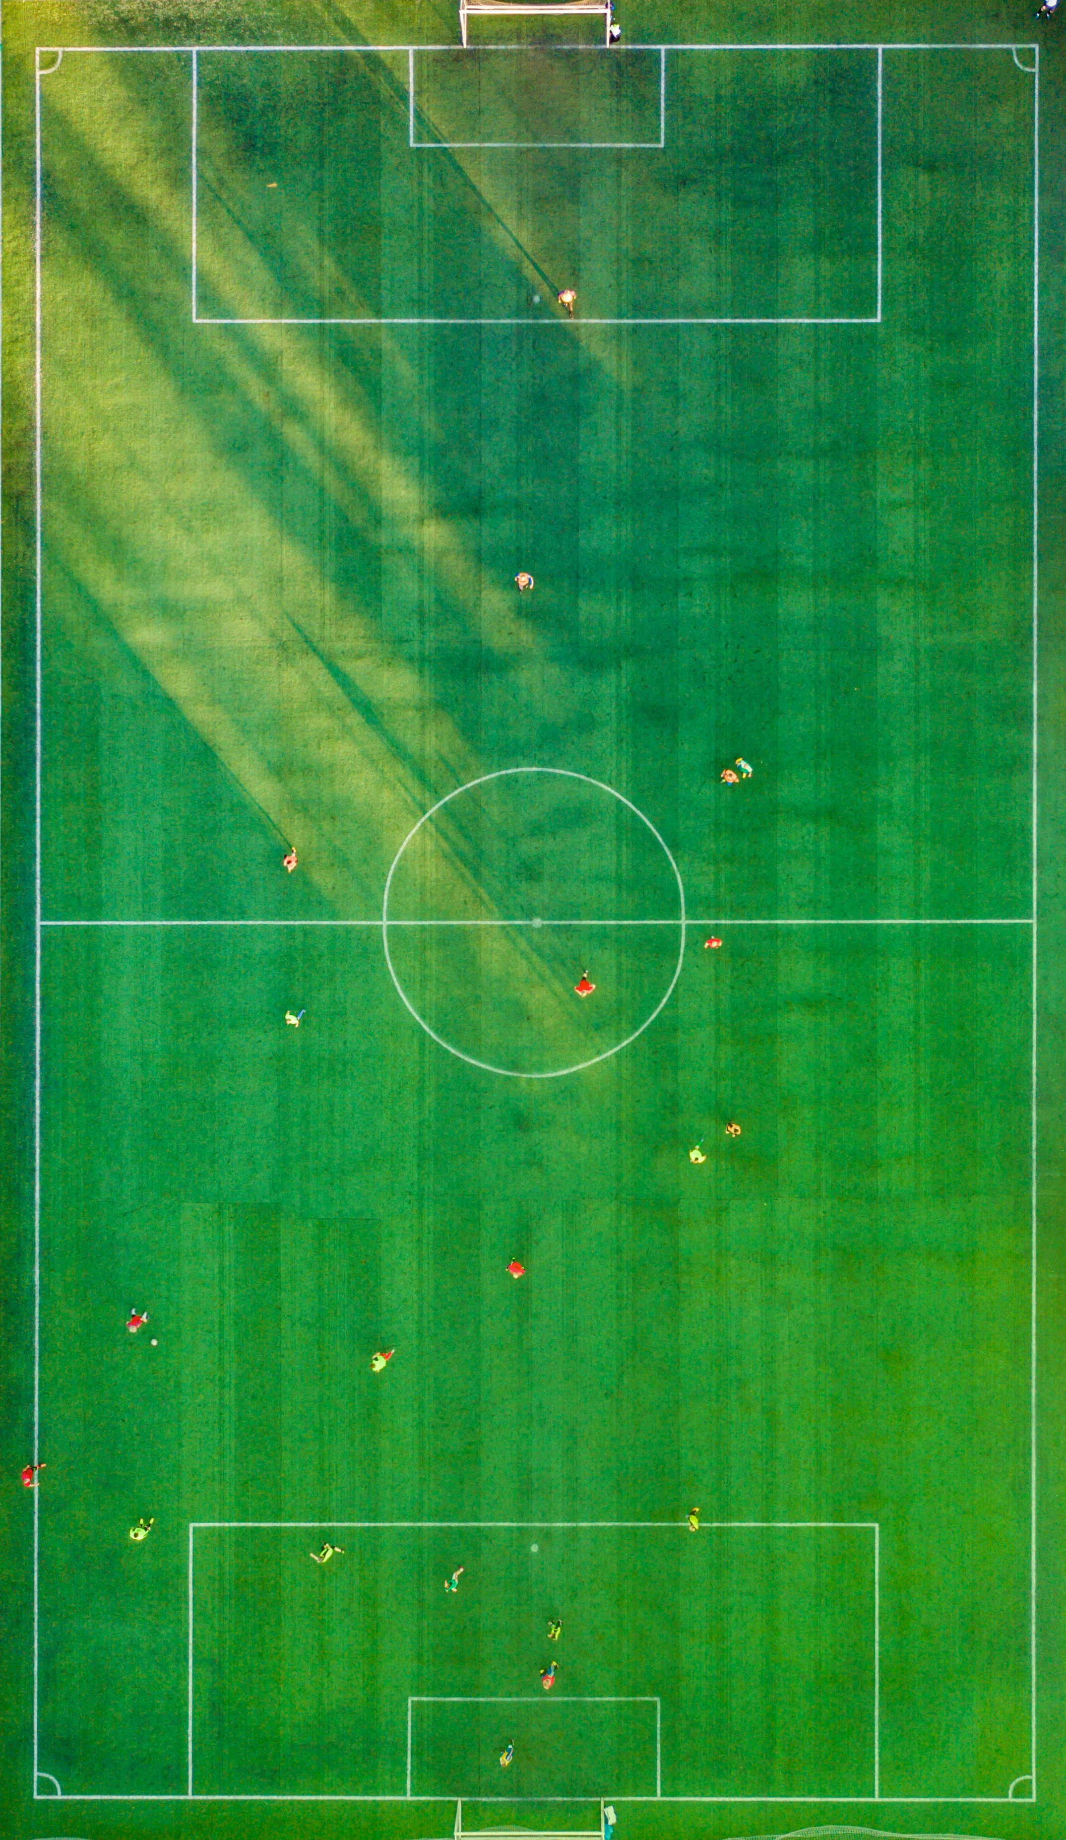
Executive summary
An introduction to FPL
How can Data Science help?
Where do FPL points come from?
Differential players
What can we do with the data?
Player ‘importance’
Network analysis
Expected goals
Tableau dashboards
Possible next steps

Slide 3
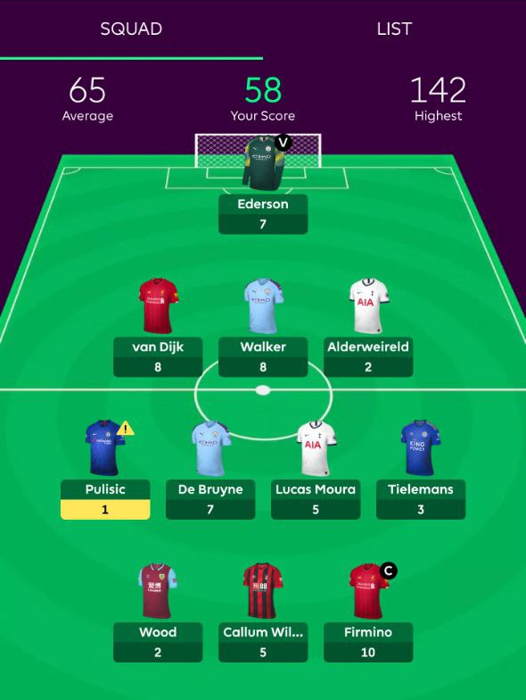
An introduction to Fantasy Premier League
Given a virtual budget of £100m, each ‘manager’ has to assemble a team of players, who score FPL points based on their performance in real life games
Famous players who scored highly in previous seasons are more expensive
Therefore, good FPL managers are those able to spot cheap, unknown players with the potential to score big
Defenders score points for keeping ‘clean sheets’
Goalkeepers score points for making saves
Midfielders and strikers score points for scoring and ‘assisting’ goals
Managers select a ‘captain’ each week. This player’s points are doubled

Slide 4
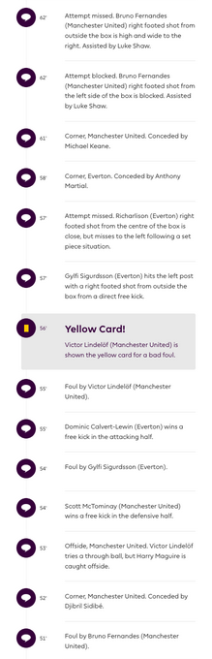
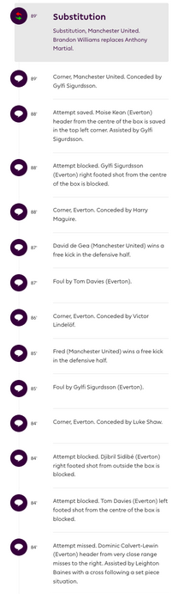
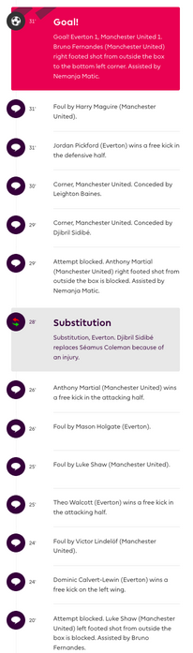
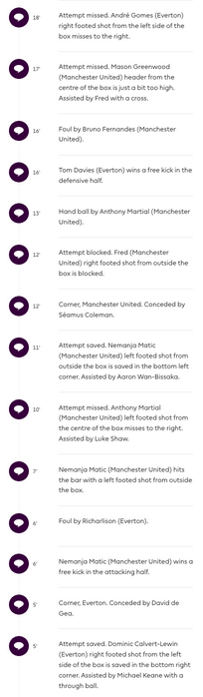

What can data science do for FPL?
Every football match generates a lot of data – both in terms of player performance and FPL manager decisions
Managers can swap one player from their team every week to bring in a replacement (who may be in better form, or have an easier run of fixtures)
The aim is to create a suite of tools that help managers make better picks throughout the season, based on the data
Data Sources
Text commentary for every match scraped from the Premier League website
‘Fantasy’ data (e.g. FPL points, player transfers, etc.) from official API
Combined, this gives a detailed view of every shot taken in every match, and an aggregate view of the decisions of each FPL manager

Slide 5
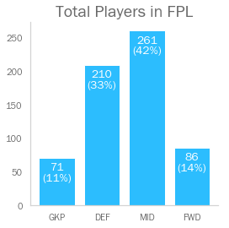
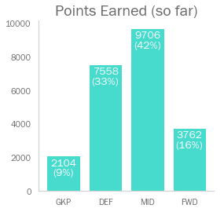
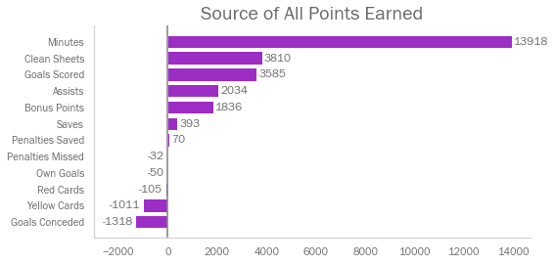
Where do FPL points come from?
The share of points earned by position reflects the number of players of each position
More than half of FPL points are generated by ‘Minutes Played’, i.e. players simply being selected to play
Keeping clean sheets and scoring goals are the most common ways to generate extra points - thus FPL managers need to be mindful of both attack and defence
It is possible for players to lose points for things like missing penalties, or conceding a lot of goals

Slide 6
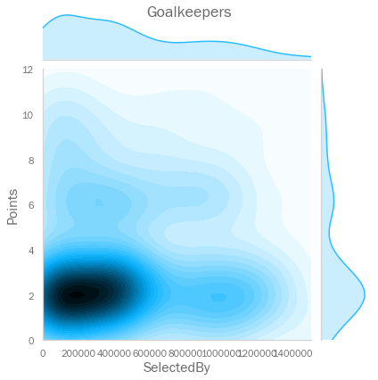
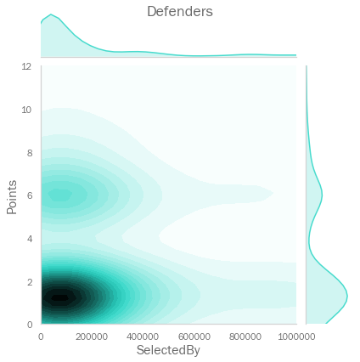
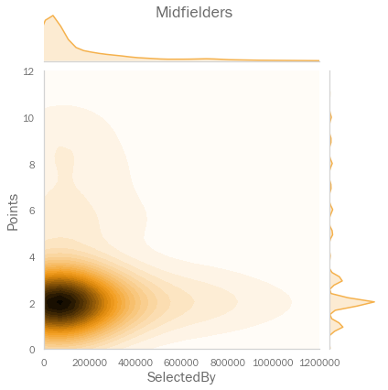
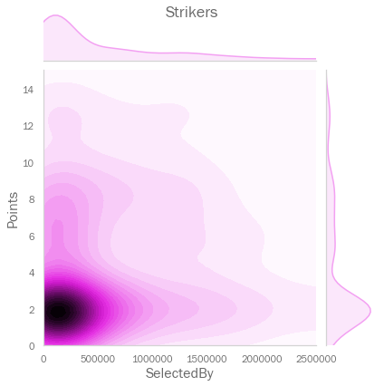
Picking ‘differentials’
Differential players are those owned by a small number of FPL managers
Consistently picking ‘differentials’ is key to FPL success – if you own a high-scoring player, this isn’t overly advantageous if the same player is owned by 50% of managers
Data suggests that there are such ‘differential’ players in the game (though they are in the minority)

Slide 7
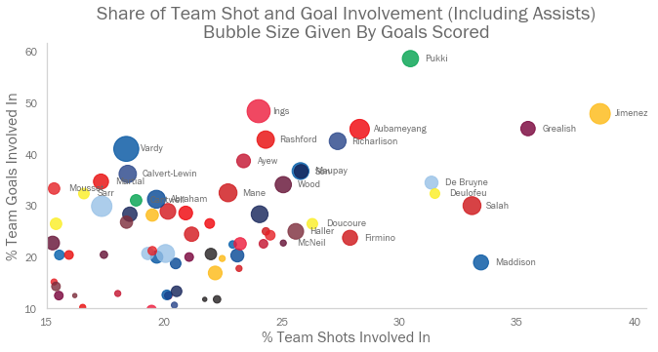
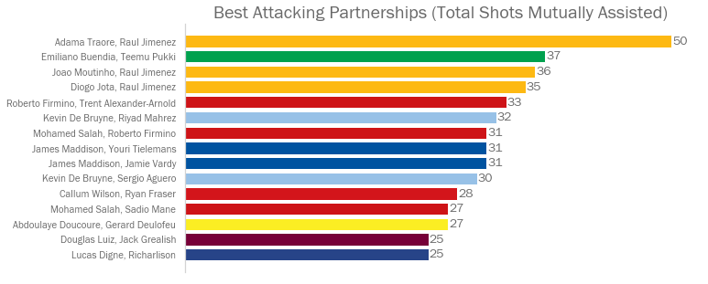
Player importance
Picking ‘important’ players of less well known teams could be a good way to spot differentials
We can start to explore which players appear to be ‘intrinsic’ to their teams’ performances
How can we analyse this more rigorously?
Raul Jiminez of Wolves has 3 of the league’s 4 most productive partnerships.

Slide 8
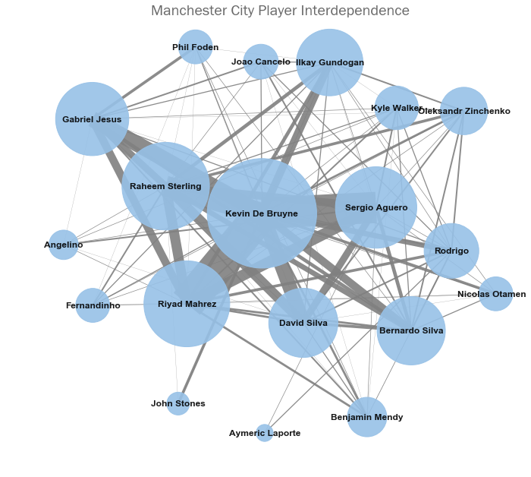
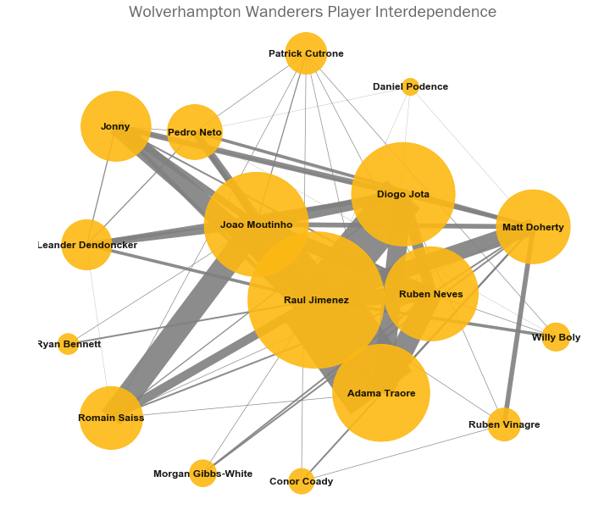
Team networks
We can think about teams like they were social networks. Then the strength of connection between two players can be given by number of times they’ve assisted each other’s shots
Then we can use ‘betweenness’ metrics to work out who the most ‘enmeshed’ (and thus, ‘important’) players are on a team by team basis

Slide 9
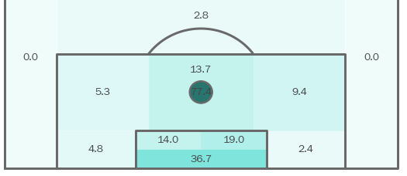
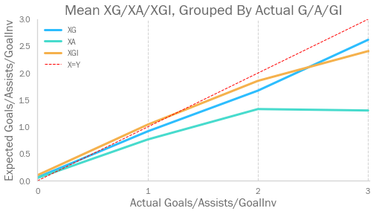
Shot quality and ‘expected goals’
Can we remove some of the sport’s intrinsic ‘randomness’ to help make our analysis more reliable?
Having defined the different types of possible shots we can see the goal conversion rate of each
We can then sum the expected conversion rates for shots that a player took in a match to give a grand ‘Expected Goals’ (XG)
% shot conversion rate

Slide 10
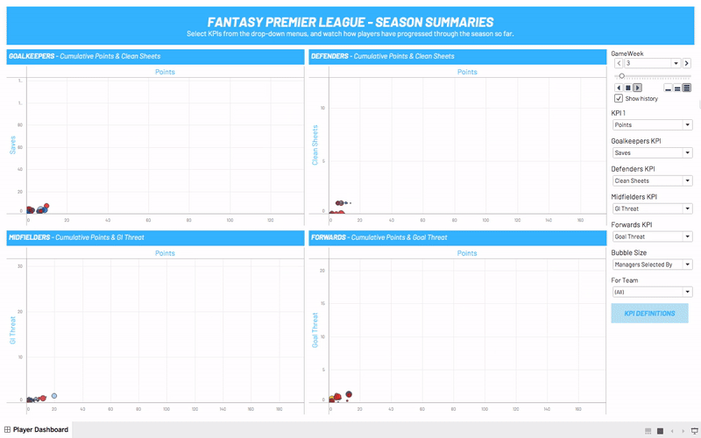
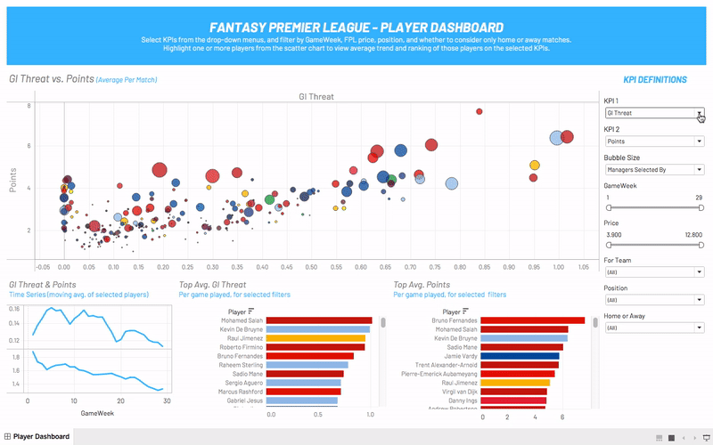
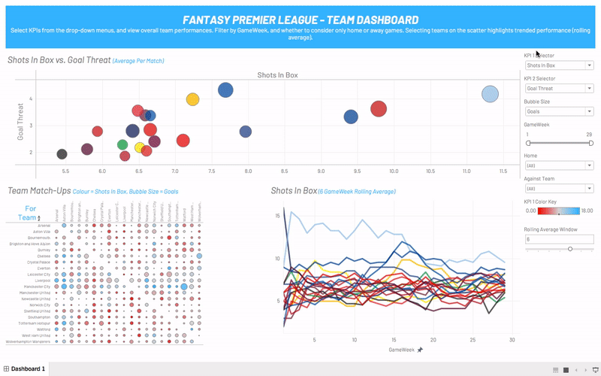
A suite of tools for FPL managers...
1) SEASON SUMMARY
2) PLAYER DASHBOARD
3) TEAM DASHBOARD
Shows how players have progressed through the season so far (by position)
Can be used to identify trends before they become obvious to every manager
KPIs fully customisable
A fully customisable dashboard showing KPIs for each player
Can filter performance based on player price, gameweek, and home/away matches
View trends/rankings of players selected in the scatter plot
A dashboard showing team-level performance across KPIs
All views and KPIs are fully customisable and can be filtered as required
Gives a view of how teams have played against each other

Slide 11
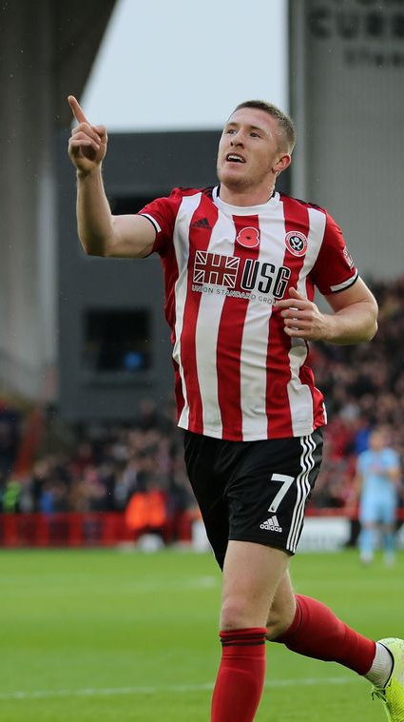
Possible next steps
There is further work that could be done using the gathered data:
Create further dashboards (e.g. using the shot level data)
Spend further time working on feature engineering to create predictive models
Get more data from previous seasons to strengthen the dataset

Slide 12
Thank you for your time
Further detail on the model, and additional analysis of the dataset is included in further pages

Slide 13
Models failed to effectively predict player XG and XGI
Model Type | Expected Goals Adjusted R² | Expected Goal Involvement Adjusted R²
Decision tree regressor | Training set: 0.1556 Test set: 0.1155 | Training set: 0.1922 Test set: 0.0762
Random Forest Regressor | Training set: 0.6059 Test set: 0.1609 | Training set: 0.3596 Test set: 0.1788
XGBoost Regressor | Training set: 0.4209 Test set: 0.1525 | Training set: 0.5945 Test set: 0.1531
Neural Network | Training set: 0.6962 Test set: -0.0167 | Training set: 0.7426 Test set: -0.0276

